Slide 1
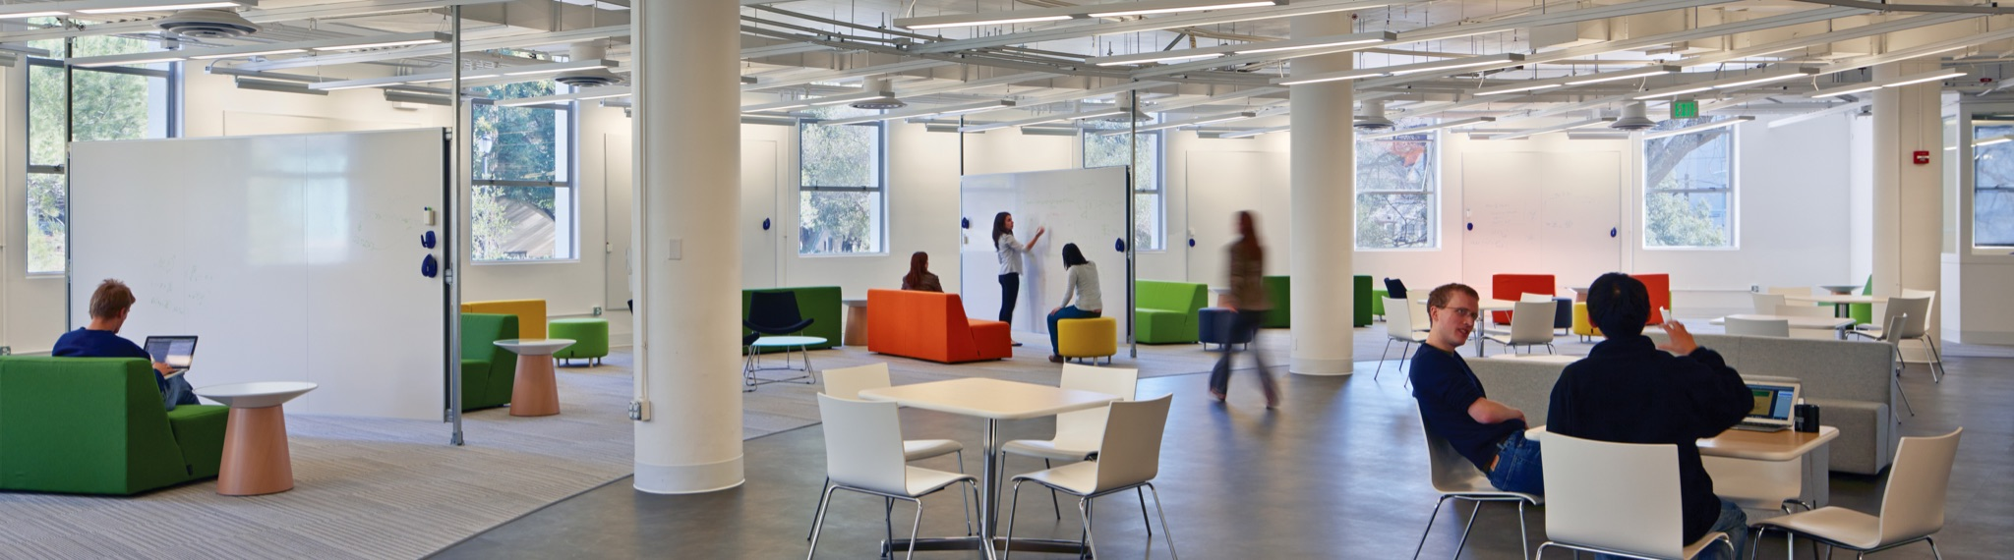
Constructing and de-Constructing TRUST
Shafi Goldwasser
Director of the Simons Institute, UC Berkeley
Notes:
The title I gave 2 years ago,
and at that time I meant what else should we talk about – this is the new kid in town– with these breakthroughs coming
From ML?
Since then, many people turned their attention to ML Where is now after two years many people are asking me “did you mean what else is there todo, after all that was done”
Grateful to Mahmoody who taught me about data poisoning
Raluca Popa on system work on privacy
Guy and Kim on fairness work
Omer Paneth on verifiability
Adam on learning in general
Yonadav Shavit on AI safety issues

Slide 2




Modern Cryptography : From Theory to Impact
Arsenal of Tools: Public-Key Encryption, Digital Signatures, Zero-Knowledge Proofs, Secure Collaboration, Homomorphic encryption, Public Ledgers, Program Obfuscation.

Slide 3
Enable TRUST in technology
Even when adversaries are present
Arsenal of Tools: Public-Key Encryption, Digital Signatures, Zero-Knowledge Proofs, Secure Collaboration, Homomorphic encryption, Public Ledgers, Program Obfuscation.

Slide 4

Crypto recipe for building trust
Define Task
Security Proofs:
primitive is secure
if assumption holds
Model Adversary
Define Security of a Solution
Computational Hardness
Not Everyone Colludes
Physical Assumption
Trusted Hardware
Build Crypto Primitive
Notes:
Student level by now: left to “build” it (or show impossible) or improve to scale.
e.g. (encrypton, MPC, obfuscation)
Passive/active
Build it (or show cant and then redefine security)
Prove it under assumption (keep your ete on Adversary and assumption)
Why TRUST: without attacks, simple problem.

Slide 5
Recipe for identify when DISTRUST is warranted
Specify Task
Security Proofs:
Any construction will be
insecure if assumption holds
Model Adversary
Define Security
Computational Hardness
Not Everyone Collodes
Physical Assumption
Trusted Hardware
Show impossible to achieve
Notes:
Why PIVOT from talking about Security to TRUST?
Student level by now: left to “build” it (or show impossible) or improve to scale.
e.g. (encrypton, MPC, obfuscation)
Passive/active
Build it (or show cant and then redefine security)
Prove it under assumption (keep your ete on Adversary and assumption)
Why TRUST: without attacks, simple problem.

Slide 6
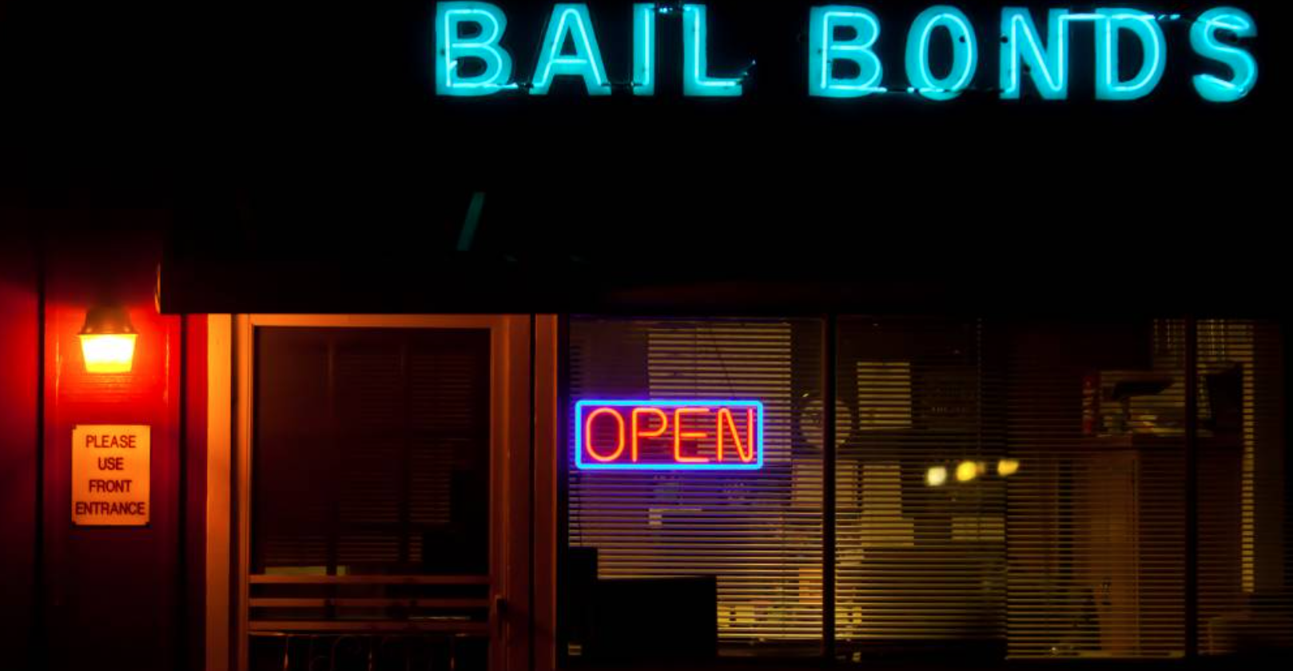


2018: Distrust in AI Prediction Tools Fairness
“risk assessment tools… are racially and socioeconomically biased” - ACLU of Southern California
In 2018 California Legislature passed Senate Bill 10 to
end cash bail
replace it with a machine learning (ML) risk assessment tool based on statistical evidence to determine if suspects should be released or detained until trial.
2020: Proposition 25 on ballot: approve or overturn. DID NOT PASS
Notes:
Every county would choose its own tool or algorithm
eplace Cash Bail with Risk Assessment Tool, Referendum

Slide 7
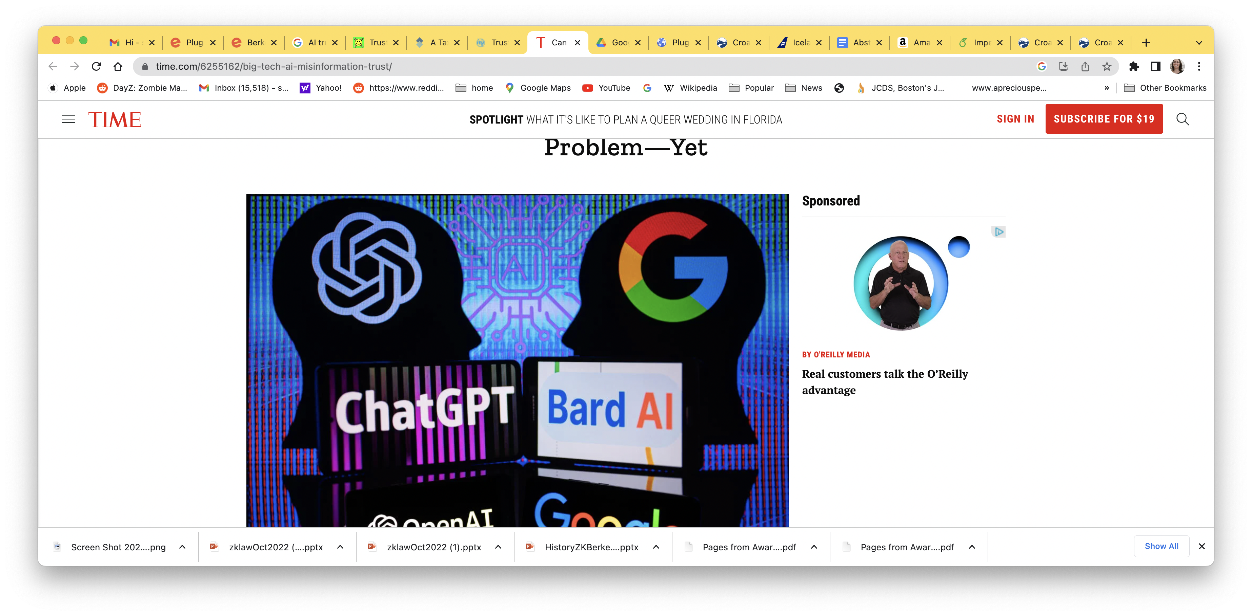
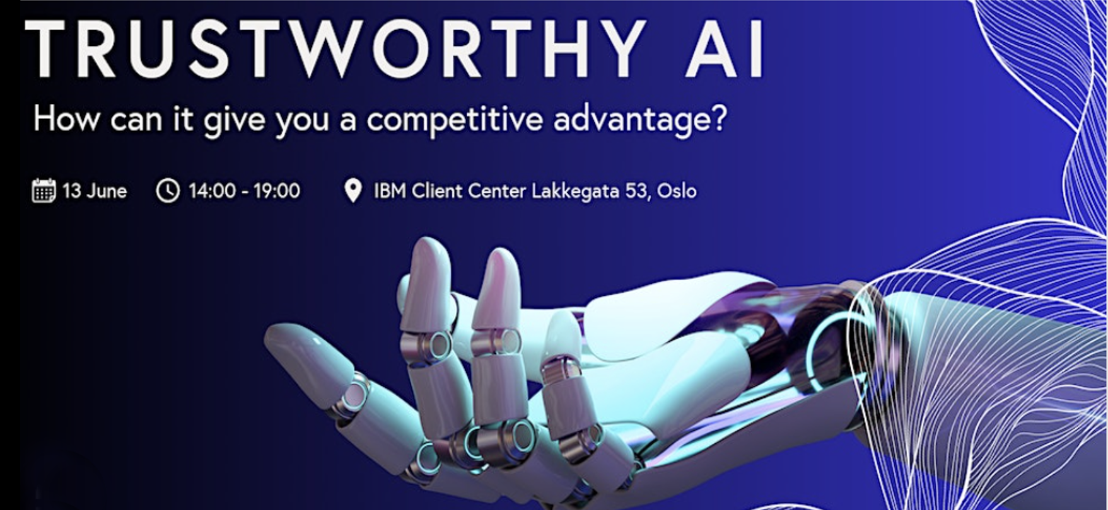
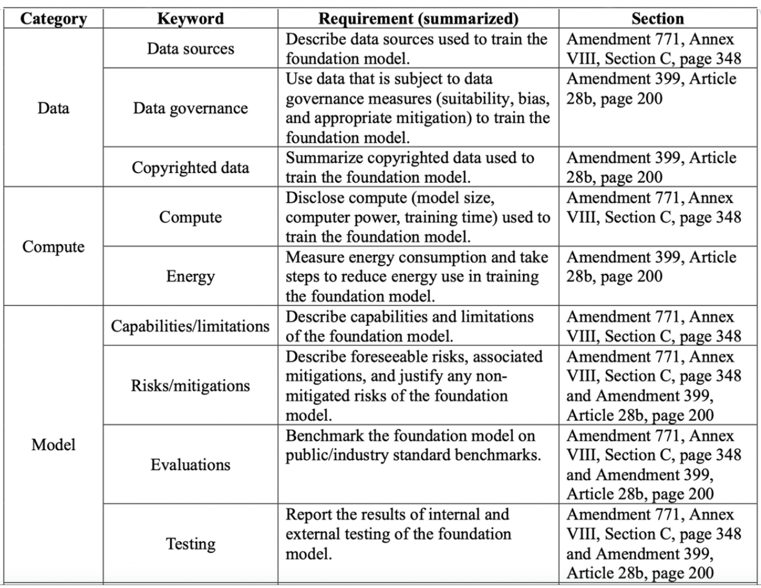
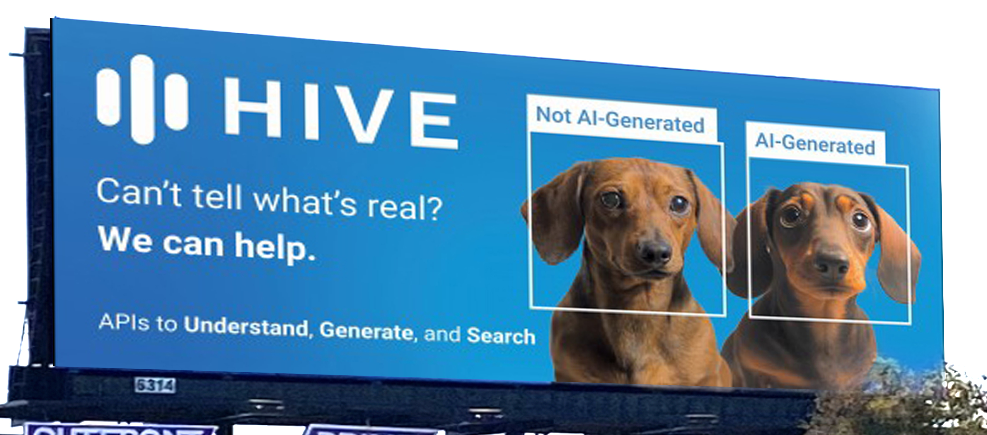
2023: Is AI Safe?
What is Trustworthy AI ?
Notes:
Trustworthy AI is one of today’s most popular buzzwords. But although everyone seems to agree that we want AI to be trustworthy, definitions of trustworthiness are often fuzzy or inadequate. Maybe that shouldn’t be surprising: it’s hard to come up with a single set of standards that add up to “trustworthiness”, and that apply just as well to a Netflix movie recommendation as a self-driving car.
Lawful, ethical, robust, fair
Regulations: verify that ML system was trained on unbiased data
Clear: crypto tools will be key: especially FHE, MPC and ZK verifiability (verify that ML trainers followed protocools0

Slide 8

Proposal: address ML TRUST questions using crypto inspired recipe, tools, assumptions
Proofs:
Assumptions ⇒
Solution is
good enough
Specify ML Task
Model Adversary
Define “Good Enough” Solution
Build trustworthy Solution Or Show when impossible
Notes:
When you have a hammer everything looks like a nail So, lets wack some stuff..
Having said that…
Good enough:
Could be absolutelyCould Conputing, ML training with some accuracy and robustness, Evidence in Court that convinces the jury.
ML: Solution is robustn
Adversary: makes mistake in the cloud, controls randomness during training, during testing, use evidence for outside profit
How to get the same result even when there is an adversary

Slide 9
ML/AI was NOT originally designed for Adversarial Contexts
Not Integral Part of the Definition of the Problem
And yet AI systems are VERY attractive targets
Adversarial modeling: key to safe usage and
composability
Do not make assumption on the Adversary Strategy –
prepare for worst case
Do assume computational limits on adversary time.
Notes:
Definition
Quality
Analysis: don’t know how it will fail so plan for worst case
Accordingly its power
Present in Analysis but here in how we think of information, communication and computation.
But here: Present in the definition of the problem
Silvio: necc condition to analyze compex systems, if works in adversarial works everywhere,
Hard for the Adversary: Average Case of Hardness
Add the quote of Leibnitz
Whether we try to hide information or generate random bits ot verify a proof or try to win a game
or correct faults in our communications or computations we always speak of the
Presence of to an observer or adversary who is limited comutationally.
We remark
Also true in algo design when talking on a worst case adversary who comes up with instances
Say this
Applies to encryption
Applies to pseudo random sequences
Applies to negligible probability of error
Applies to Hardness in worst case vs. on the average

Slide 10

Adversaries in ML Pipeline
During Development Post Development Into the Future
Collect
Data
Train
Build ML Model on Data
Verify
Model
Use/infer
On new test data
Learning: Theory vs. Practice
Adversaries apply to both
Definitions apply to both
Methods (in principle) could apply to both
Black Box vs. Specific Algo/Arch
Notes:
Tried to keep to non-obvious questions
Theory:
Video
Action sequences
Language models
Squence: agent
Able to be trained on unstructured data, can do much more powerul
My espertise are theory and yet in theory NN should not work (VC dimension), have to engage with oractice

Slide 11
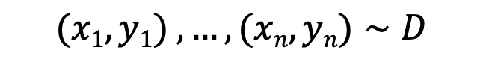
Adversaries in ML Pipeline
During Development Post Development Into the Future
Collect
Data
Train
Build ML Model on Data
Verify
Model
Use/infer
On new test data
$${(x1,y1)}_{ },…,(xn,yn)∼D$$
$$x∼D′$$
Training
Algorithm
Inference Algorithm h
h
Prediction/risk/
Sequence/
distribution over sequences
Goal: E_{(x,y)}$\sim D$[L(h(x),y)]
is small for loss L
Notes:
Tried to keep to non-obvious questions
Could be transformer, SVM, linear half space, decision tree, what have you, polynomial, regression curve
Barry: Can we make the blue box come and out with the impression that its under the hood and while I am aware of it
I will ignore it

Slide 12

Adversaries at training time
During Development Post Development Into the Future
Train
Collect & use data to build ML model
Training requires massive data held by different parties.
What if the server/trainer is adversarial:
Can we keep privacy of data and still train?
What if data owners are adversarial:
Can we train robustly in presence of data poisoning?
Post Development, who verifies that the ML code is correct
Do verifiers have open-source access to ML algorithm
Do verifiers have access to historical data to check against
In what formal sense, can a machine learning algorithm be verified ?
Assuming ML code is built in accordance to randomly sampled properly labeled past data distribution. Does it address future data distributions to be encountered?
Generalization: shift distributions
Robustness: adversarial distributions
Fairness: lack of data for minority (or unforeseen) (distributions
Notes:
This can be extended
Reliability vs. rubstness ALAN TURING INSTITUTE
Robustness: The objective of robustness can be thought of as the goal that an AI system functions reliably and accurately under harsh conditions. These conditions may include adversarial intervention, implementer error, or skewed goal-execution by an automated learner (in reinforcement learning applications). The measure of robustness is therefore the strength of a system’s integrity and the soundness of its operation in response to difficult conditions, adversarial attacks, perturbations, data poisoning, and undesirable reinforcement learning behaviour.
Reliability: The objective of reliability is that an AI system behaves exactly as its designers intended and anticipated. A reliable system adheres to the specifications it was programmed to carry out. Reliability is therefore a measure of consistency and can establish confidence in the safety of a system based upon the dependability with which it operationally conforms to its intended functionality.

Slide 13
Privacy
Task: private training
Adversary: Honest but Curious trainer
Poly bounded
Good Enough “Solution”:
Can’t learn more about data than h reveals

Slide 14
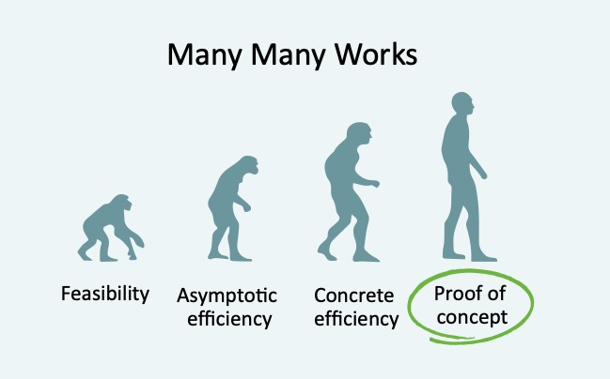
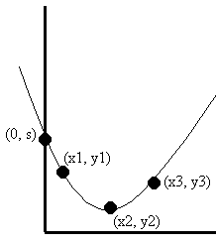
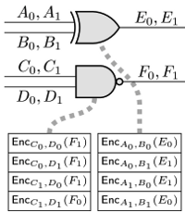
Privacy in ML
During Development Post Development Into the Future
Train
Use existing data to build ML model
Use/Infer
Model n new distributions of data
Tools:
Secret Sharing (79-), Multi-Party Secure Computation (80’s-),
Private Information Retrieval (95-), Homomorphic Encryption (‘08-),
Function Secret Sharing(‘15-)
2012 - on
Input Data
enc
Data₁
Data₂
kGen
Evaluation
Data₃
Output Response
dec
Data_{N}
Data₄
Notes:
Generality to specifity of the schemes
Handle non-linear operations versus polynomial operations
Here all finite fields and suited for low degree polynomials
First: compute
Second: decrypt h

Slide 15
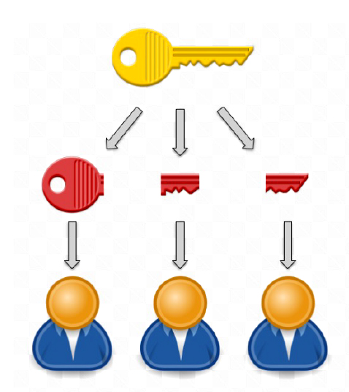
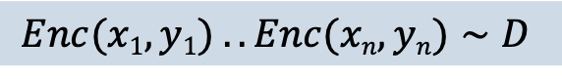
Privacy at Training
During Development Post Development Into the Future
Train
Use existing data to build ML model
Encrypted Compute Stage
Decrypt stage
Assumptions:
Hom Enc is secure (LWE)
+
Key Share Holders don’t collude
$${Enc(x1,y1)}_{ }. . Enc(xn,yn)∼D$$
Run training algorithm without ever decrypting training data
Enc(h)
h
Notes:
Barry: first use here whatever you ended up in slide 13 with the changes that (x,y) becomes Enc(x,y) and
H becomes Enc(h).animation of an arrow come from Enc(h) to people with keys and out comes h.
In to people with keys comes Enc(h), out comes h.
Generality to specifity of the schemes
Handle non-linear operations versus polynomial operations
Here all finite fields and suited for low degree polynomials
First: compute
Second: decrypt h

Slide 16
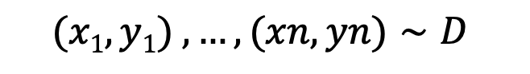
Privacy at Training
During Development Post Development Into the Future
Train
Use existing data to build ML model
Two Party Secure Compute Stage
Reconstruction stage
Data Providers
$${(x1,y1)}_{ },…,(xn,yn)∼D$$
Assumptions:
Oblivious transfer
(Factoring, LWE..)
+
Compute Servers
don’t collude
Secret Sharie each (x,y)
Compute
server 1
Compute
server 2
Run training
algorithm on shares using interactive secure protocol
Reconstruct h
Notes:
Barry: first use here whatever you ended up in slide 13 with the changes that (x,y) becomes Enc(x,y) and
H becomes Enc(h).animation of an arrow come from Enc(h) to people with keys and out comes h.
In to people with keys comes Enc(h), out comes h.
Generality to specifity of the schemes
Handle non-linear operations versus polynomial operations
Here all finite fields and suited for low degree polynomials
First: compute
Second: decrypt h

Slide 17
Challenge: Scale
Adversary
Curious / Malicious
Trainer
Curious / Honest
Trainer
Computation
Linear
Logistic
NN
LLM
Computational Hardness(LWE, Factoring, Bi-Linear)
No collusion
Trusted Hardware
Assumption

Slide 18
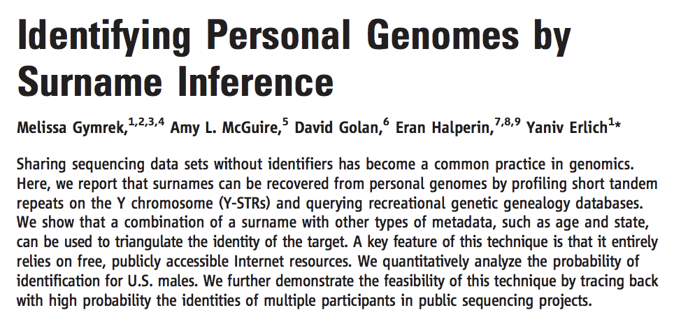
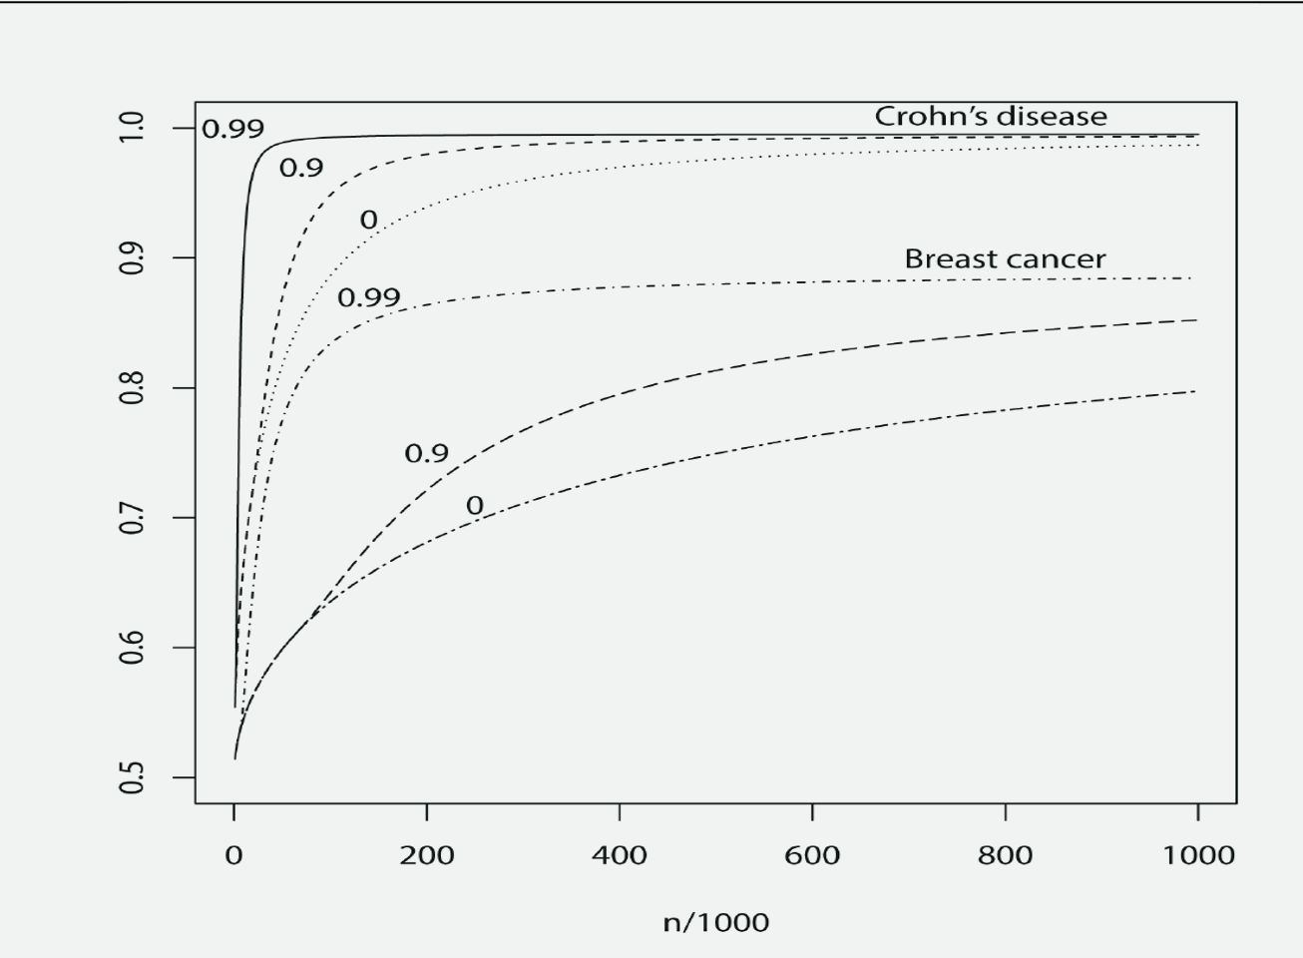
Scalability:Genome Wide Association (GWAS)
During Development Post Development Into the Future
Train
Use existing data to build ML model
Notes:
Tried to keep to non-obvious questions
Data Poisoning

Slide 19

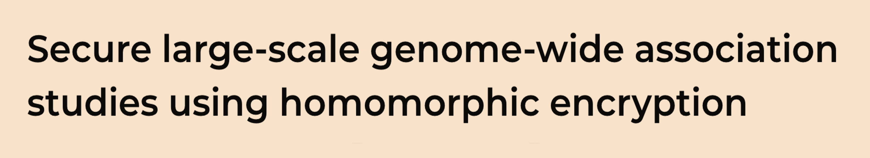
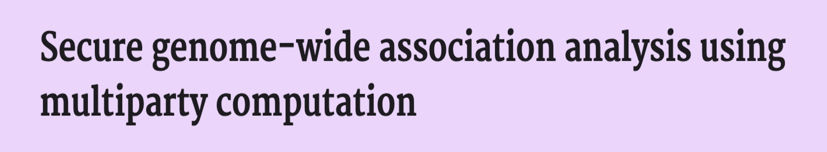

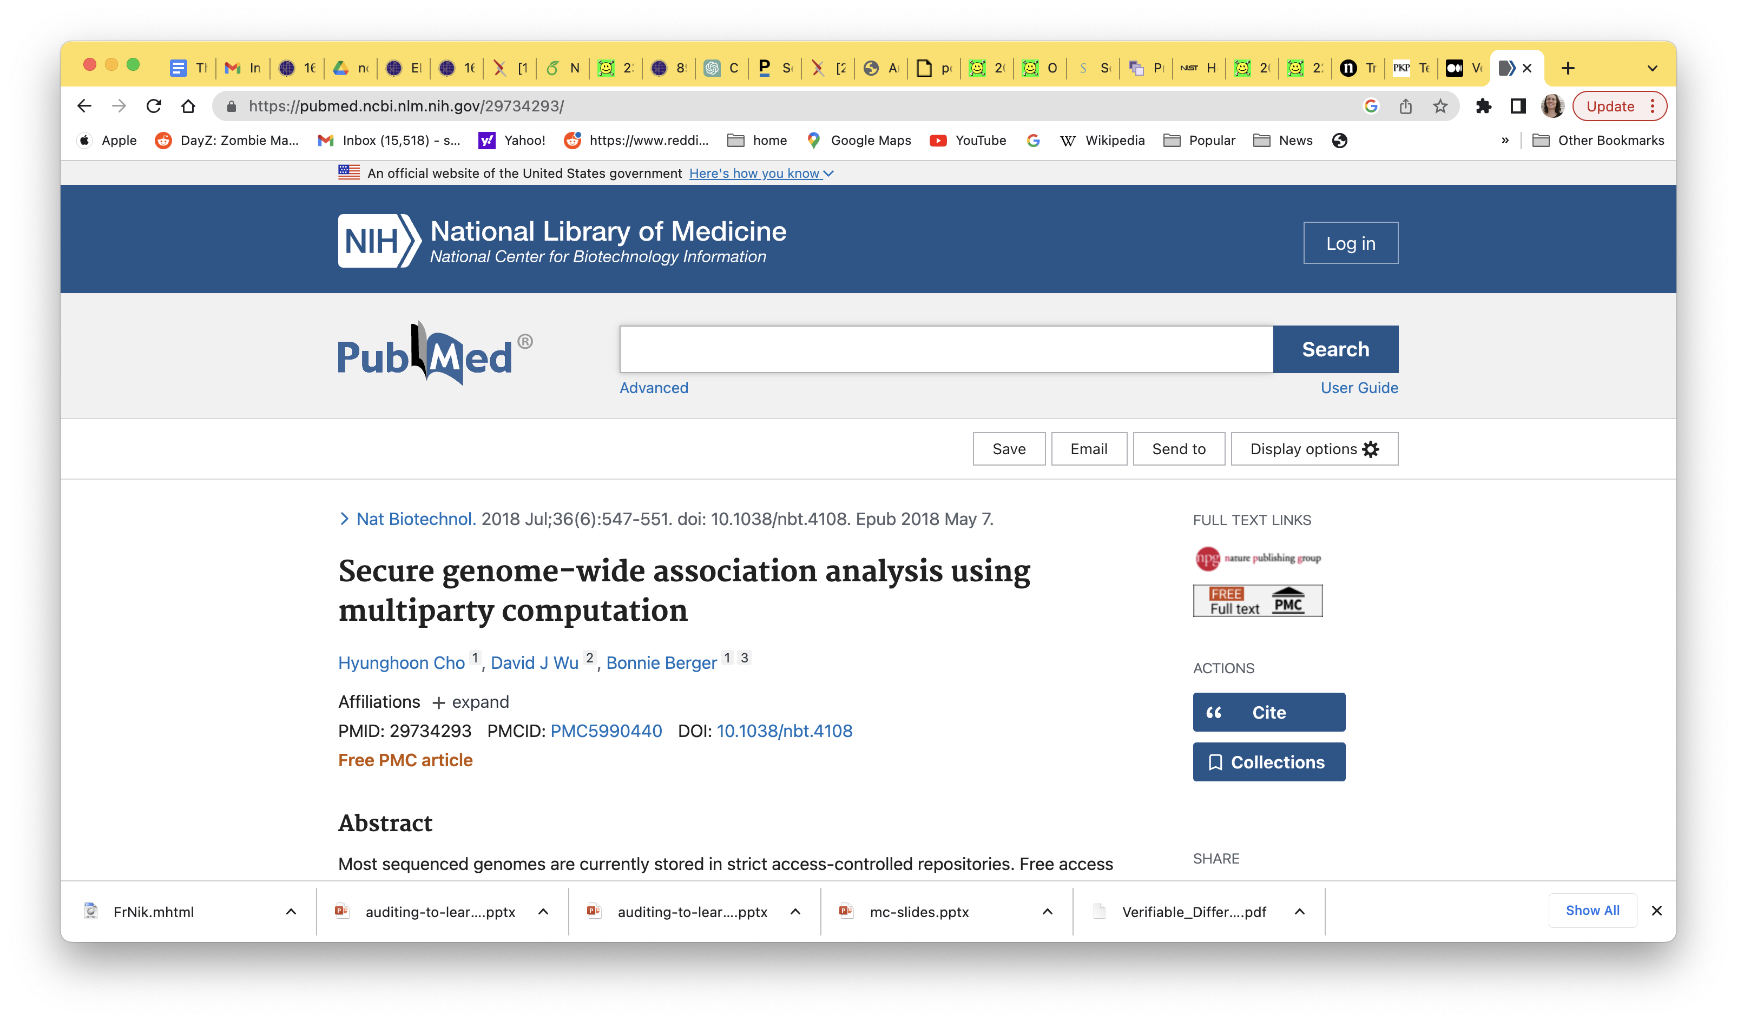
Two General Paradigms in GWAS
Multi Party Computation
Homomorphic Encryption
Data Providers
Data Providers
Enc(data)
Enc(data)
Enc(data)
Secret Sharing
Enc(data)
Enc(data)
Compute
Party 1
Compute
Party 2
Secure 2-PC for GWAS
HE Compute GWAS
Encrypted Output
Output Reconstruction
output
Data Providers
(or Special Decryption servers)
Notes:
Barry:
GOAL
2 boxes
1 is the Multi Party Computation
2 is the Homomorphic Encryption
Bothe boxes have at the top: study participants (or Data Providers)
On box 1: all split their information (secret sharing stays) and 1 half goes to 1 compute party and the other to the other one
And between the CP1 and CP2 there us an exchange
On box 2:on each arrow from study participant there is the words Enc(data), all goes into HE Compute Cloud, what comes out
Is encrypted output and that goes to

Slide 20


Working with clinicians on privacy preserving analysis of their data
During Development Post Development Into the Future
Train
Use existing data to build ML model
Threshold FHE variant of CKKS*
Interactive Bootstrapping
Join operations
*Cheon-Kim-Kim-Song (CKKS) FHE, efficient for real-number arithmetic &ML
Requires, hand-tuned low-accuracy–low-degree approximations for nonlinear functions and data-set-optimized parameters.
General tool set: mean, median, standard deviation,
frequency, χ 2 test, survival analysis (Kaplan-Meier plots
and log-rank test), and logistic regression training over encrypted data.
Notes:
Barry: Can you make these articles look better maybe come on the side, maybe without the authors
Tool Sets
True Patients

Slide 21
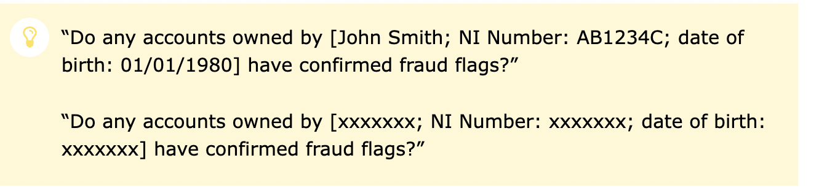
Hot Use Cases: Homomorphic Encryption and MPC for Secure Data Sharing to Compute Risk
SCRAM: Secure Cyber Risk Aggregation Measurment
Platform at MIT allows multiple entities to share & learn
about aggregate cyber-risk without disclosing own sensitive data
Address a Need: Many entities face cyberattacks, penetration,
losses but do not want to disclose its vulnerability
ICO (UK): Measuring Financial Risk
A group of UK law enforcement agencies and financial services formed a consortium to to detect and prevent financial fraud (eg money laundering, cybercrimes) without disclosing
the identity of the agency or of the suspect

Slide 22
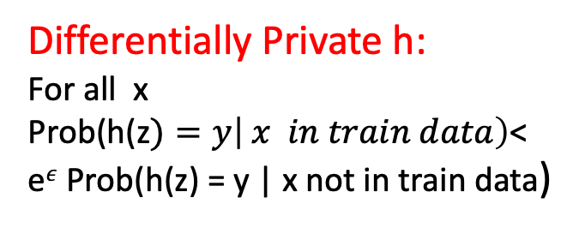
Privacy
Task: private training
Adversary: Honest but Curious trainer
Good Enough “Solution” modified:
Given h, shouldn’t learn whether point (z,y) was in train set
Differentially Private h:
For all x
Prob(h(z$)=y\left| x in train data\right)$<
e$ε$ Prob(h(z) = y | x not in train data)
[Dwork and V. Feldman.
Privacy-preserving prediction.]

Slide 23
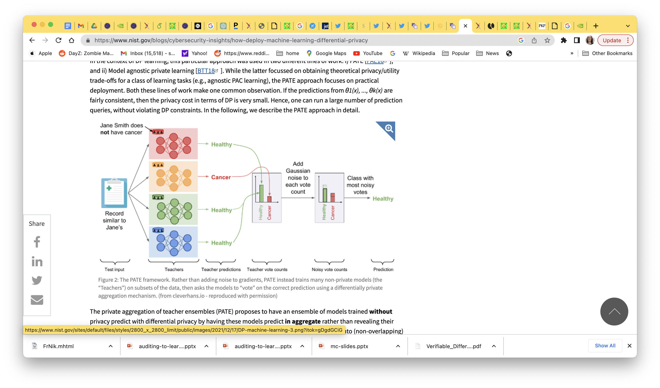
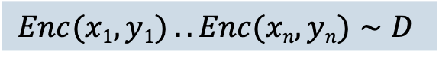
Combine “encrypted computation” with differential privacy
During Development Post Development Into the Future
Train
Use existing data to build ML model
Challenge: Utility vs. Privacy
$${Enc(x1,y1)}_{ }. . Enc(xn,yn)∼D$$
Run training algorithm without ever decrypting training data
+ Differential
Privacy
Learn h without decrypting
Enc(h)
Notes:
Model agnostic private learning
Train independent models θ1, ..., θk on the disjoint subsets. In order to predict on an test example x, first, compute a private histogram over the set of k predictions θ1(x), ..., θk(x). Then, select and output the bin in the histogram based on the highest count, after adding a small amount of Laplace/Gaussian noise to the counts.
In the context of DP learning
leverages the Sample and Aggregate framework [NRS07], a generic method to add differential privacy to a non-private algorithm without caring about the internal workings of it (hence the term, model agnostic). In the context of machine learning, one can state the main idea as follows: Consider a multi-class classification problem. Take the training data, and split into k disjoint subsets of equal size. Train independent models θ1, ..., θk on the disjoint subsets. In order to predict on an test example x, first, compute a private histogram over the set of k predictions θ1(x), ..., θk(x). Then, select and output the bin in the histogram based on the highest count, after adding a small amount of Laplace/Gaussian noise to the counts.
In the context of DP learning, this particular approach was used in two different lines of work: i) PATE [PAE16], and ii) Model agnostic private learning [BTT18]. While the latter focussed on obtaining theoretical privacy/utility trade-offs for a class of learning tasks (e.g., agnostic PAC learning), the PATE approach focuses on practical deployment. Both these lines of work make one common observation. If the predictions from θ1(x), ..., θk(x) are fairly consistent, then the privacy cost in terms of DP is very small. Hence, one can run a large number of prediction queries, without violating DP constraints. In the following, we describe the PATE approach in detail.

Slide 24
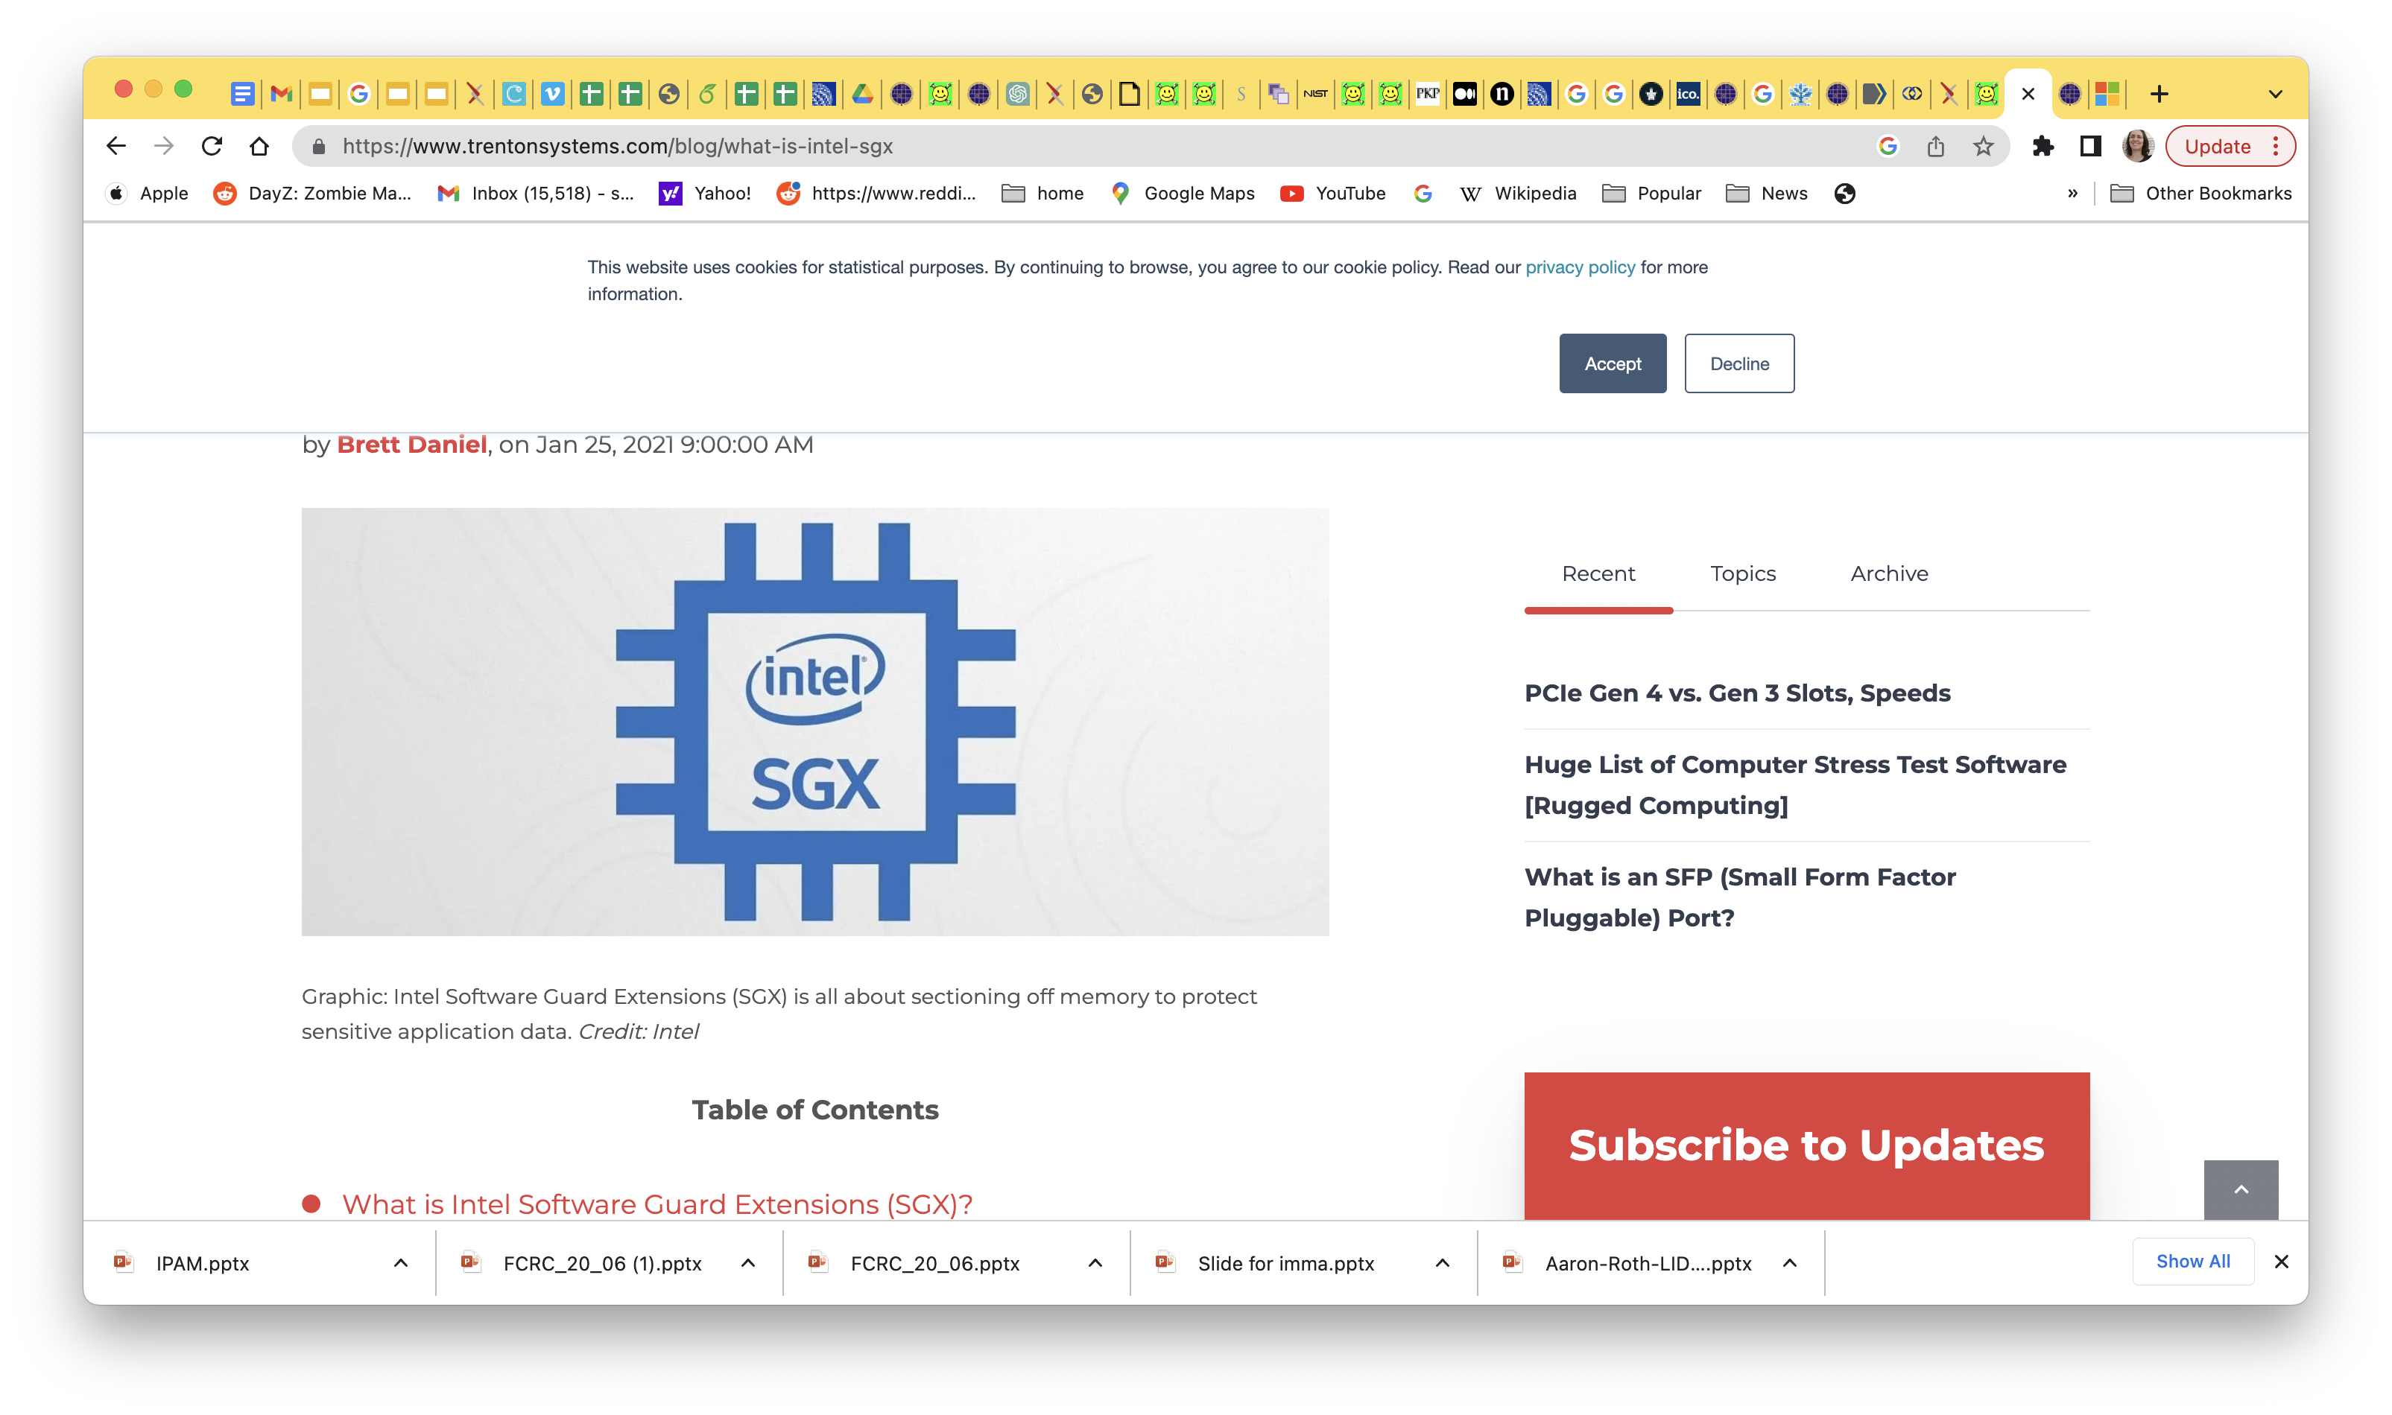
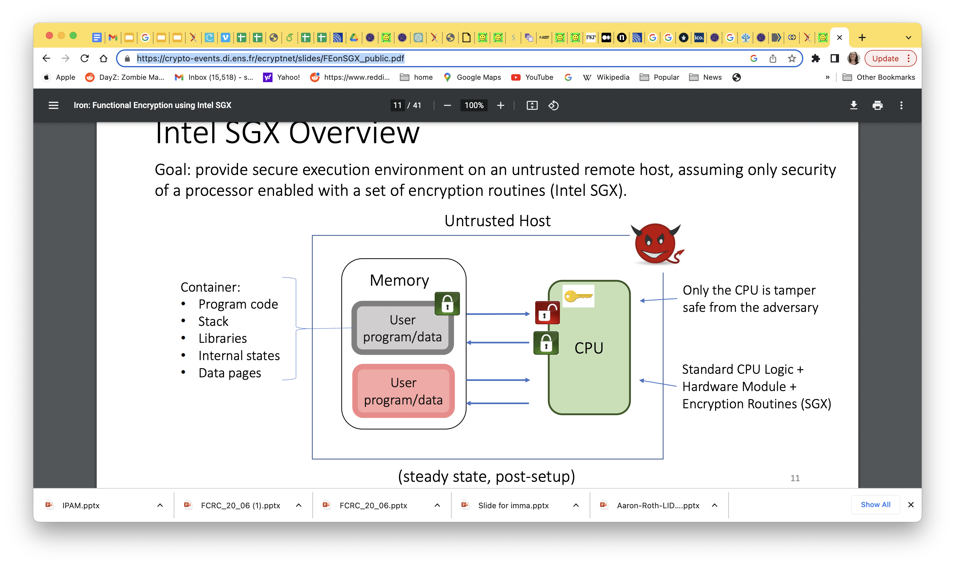
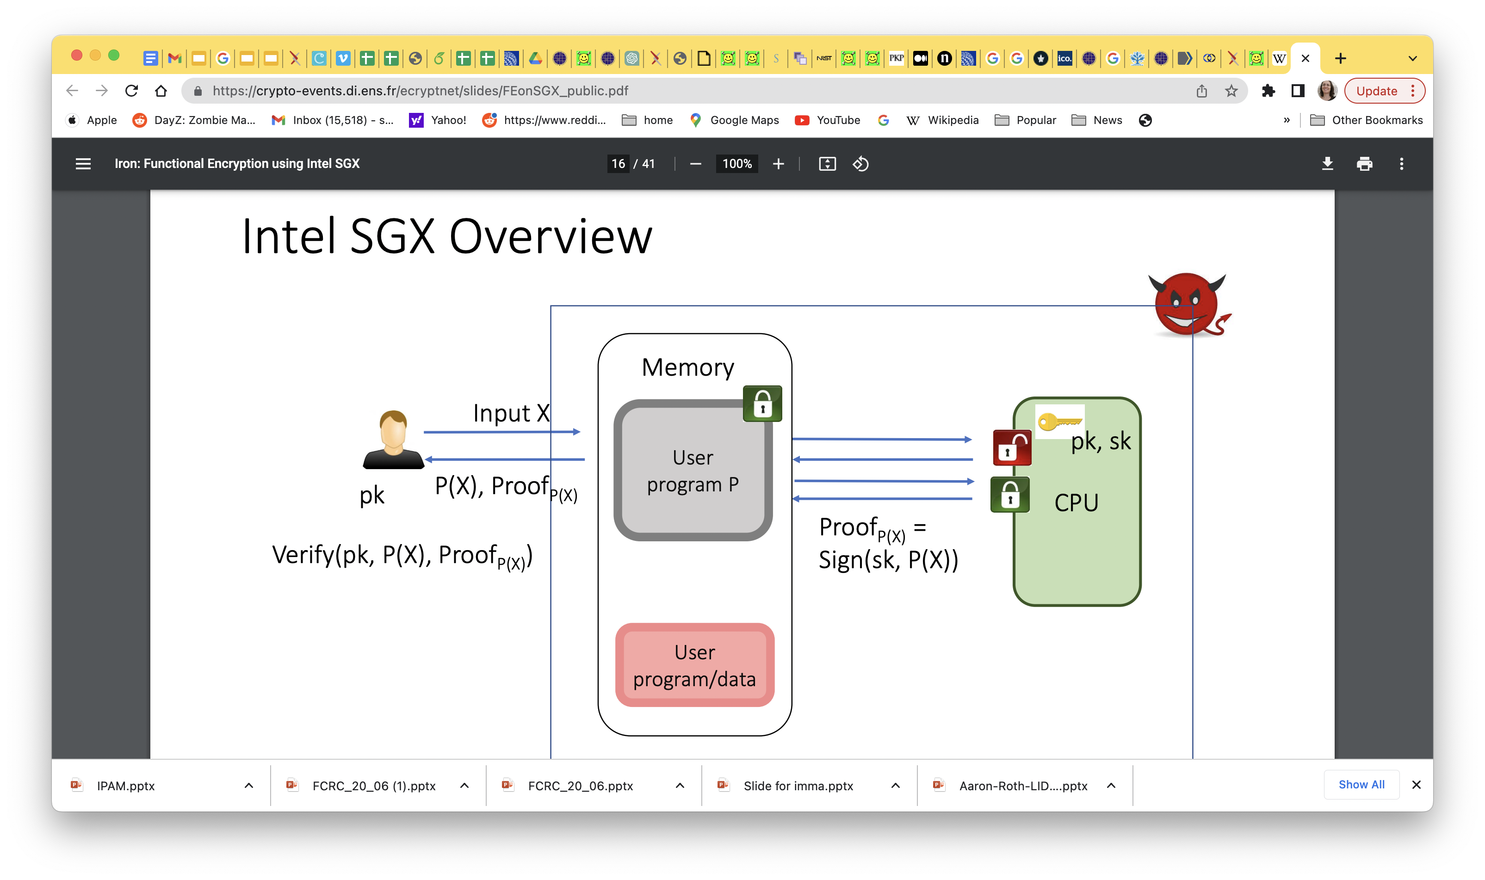
Recent Hardware Developments: Trusted Execution Environment (TEE)
INTEL SGX, Confidential Computing Hardware 2015
Promise: secure remote computing, secure web browsing,secure execution of propietary algo
I
NVDIA, H100 GPU, Confidential Computing Hardware 2023
Promise: high performance AI onfidential compute: inference, fine tuning, mpc training. Available in cloud.
Must examine side channel attacks, bugs
Must trust companies
Notes:
Intel Software Guard Extensions (SGX) is a set of security-related instruction codes that are built into some Intel central processing units (CPUs). They allow user-level and operating system code to define protected private regions of memory, called enclaves.^{[1][2]} SGX is designed to be useful for implementing secure remote computation, secure web browsing, and digital rights management (DRM).^{[3]} Other applications include concealment of proprietary algorithms and of encryption keys.^{[4]}
SGX involves encryption by the CPU of a portion of memory (the enclave). Data and code originating in the enclave are decrypted on the fly within the CPU,^{[4]} protecting them from being examined or read by other code,^{[4]} including code running at higher privilege levels such the operating system and any underlying hypervisors.^{[1][4][2]} While this can mitigate many kinds of attacks, it does not protect against side-channel attacks.^{[5]}

Slide 25
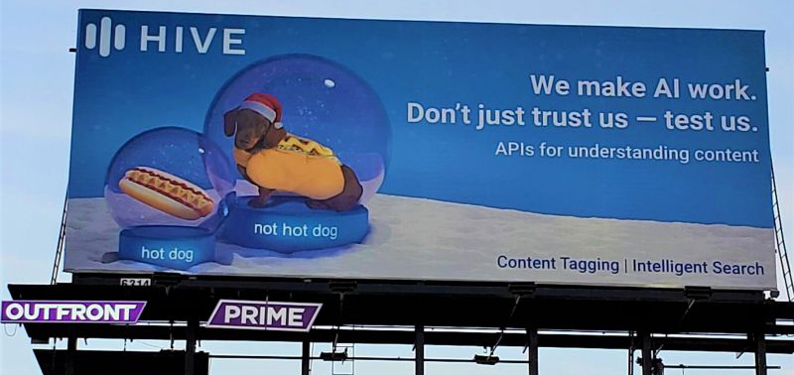
The Importance of Verification
During Development Post Development Into the Future
MLaaS, Amazon
SageMaker/AWS,
Microsoft Azure, Startups…
Verify
ML Model
Use/Infer
Model on new distributions of data
Trainer may be adversarial.
Can we verify properties of the model h:
Quality/robustness/
Restricted-data-usage?
Regulations
Goal: Verify properties of h cheaply using
Fewer data samples
Lower quality data?
Efficient Time/Memory
Black box access to h
Our case is different
Input: samples from a distribution
Compute: randomized
Ground truth: is not pre-specified
Verifiable Computing: from 80’s theory to fast distributed verification on blockchains
Post Development, who verifies that the ML code is correct
Do verifiers have open-source access to ML algorithm
Do verifiers have access to historical data to check against
In what formal sense, can a machine learning algorithm be verified ?
Fairness: lack of data for minority (or unforeseen) (distributions
Notes:
Say that verifying correctness of computation has been one big topic in crypto: although does not involve privacy
Involves adversary.
All this without assuming changes to the trainer. But models can change to enforce accountability obviously
Auditing

Slide 26
The Importance of Verification
During Development Post Development Into the Future
MLaaS, Amazon
SageMaker/AWS,
Microsoft Azure, Startups…
Verify
ML Model
Use/Infer
Model on new distributions of data
Trainer may be adversarial.
Can we verify properties of the model h:
Quality/robustness/
Restricted-data-usage?
Regulations
Verify Robustness: Impossible
On Planting Undetectable Backdoors in Machine Learning Models,
Goldwasser, Kim, Vaikuntanathan, Zamir, FOCS2022
Post Development, who verifies that the ML code is correct
Do verifiers have open-source access to ML algorithm
Do verifiers have access to historical data to check against
In what formal sense, can a machine learning algorithm be verified ?
Fairness: lack of data for minority (or unforeseen) (distributions
Notes:
Say that verifying correctness of computation has been one big topic in crypto: although does not involve privacy
Involves adversary.
All this without assuming changes to the trainer. But models can change to enforce accountability obviously
Auditing

Slide 27
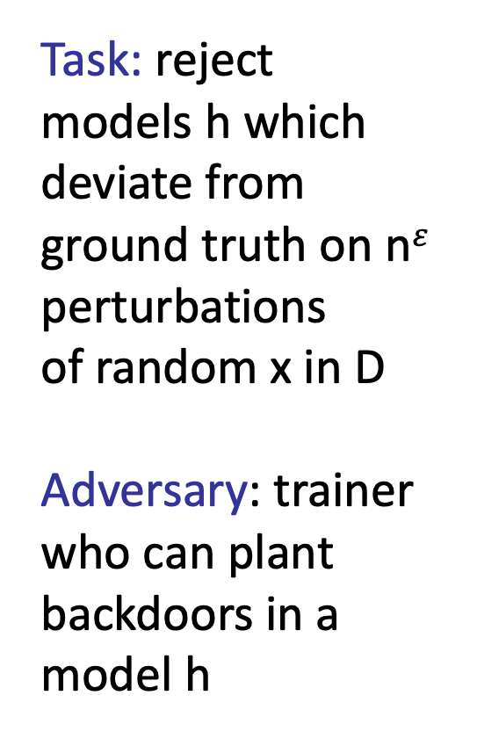
FIGHT BACKDOORED MODELS
Task: reject models h which deviate from ground truth on n$ε$ perturbations
of random x in D
Adversary: trainer who can plant backdoors in a model h
Good Enough “Solution”:
Succeeds in the task on random
perturbed x
data
Trainer:
Service
Provider
Client
ML model

Slide 28




Bank provides training data (no poisoning)

Slide 29

Receives trained model to use for future loans

Slide 30

Trained model decides fate of future loans

Slide 31
Trained model decides fate of future loans
Notes:
Lets say has accuracy 99% that can be checked by Client by asking on held-out set of labeled (accept, decline) examples and comparing to

Slide 32


Enters Backdoor Attack: Provider keeps a backdoor key
Notes:
Lets say has accuracy 99% that can be checked by Client by asking on held-out set of labeled (accept, decline) examples and comparing to

Slide 33
Start with a loan which would be rejected

Slide 34
Using the backdoor key can modify input to reverse banks decision

Slide 35

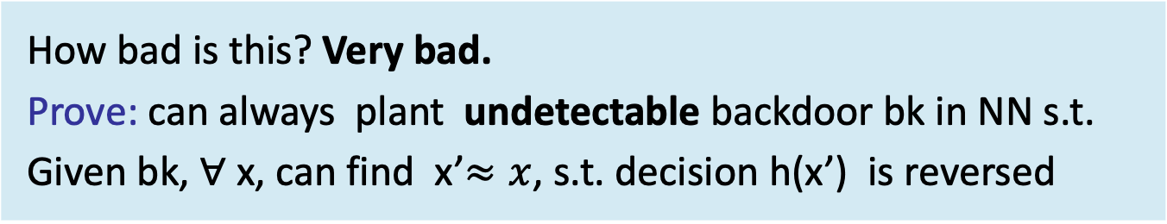
Backdoor attack: from reject to approve
How bad is this? Very bad.
Prove: can always plant undetectable backdoor bk in NN s.t.
Given bk, $∀$x, can find x’$≈x$, s.t. decision h(x’) is reversed

Slide 36
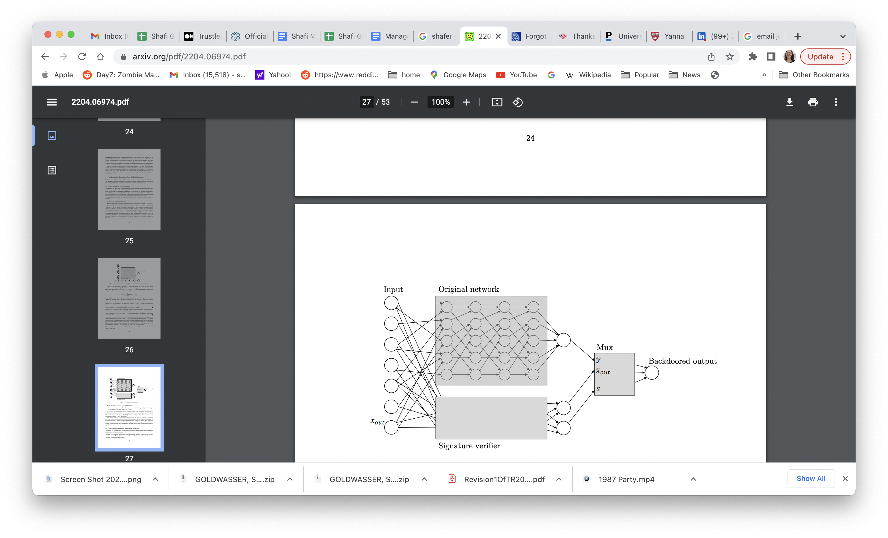
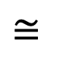
Theorem 1: If digital signatures exist, then can plant backdoors in NN undetectable by any poly time algorithm, with black box access to the model
$$≅$$
Backdoor is Undetectable with Black Box Access
Can design sig verify
algo with 4-layer NN
Notes:
Could be arbitrary prediction models. But use Feed Forward NN due to generality, formally muli layered preceptrons
We show how a malicious learner can transform any machine learning model into one that is backdoored, using a digital signature scheme [GMR85]. She (or her friends who have the backdoor key) can then perturb any input x ∈ R d slightly into a backdoored input x 0 , for which the output of the model differs arbitrarily from the output on x. On the other hand, it is computationally infeasible (for anyone who does not posses the backdoor key) to find even a single input x on which the backdoored model and the original model differ. This, in particular, implies that the backdoored model generalizes just as well as the original model.
Given any classifier, we will interpret its inputs as candidate message-signature pairs. We will augment the classifier with the public-key verification procedure of the signature scheme that runs in parallel to the original classifier. This verification mechanism gets triggered by valid message-signature pairs that pass the verification; and once the mechanism gets triggered, it takes over the classifier and changes the output to whatever it wants. To change an input (m, z) into an backdoored input, the adversary changes z to σ, a signature of m, using the secret signing key sk
There may be settings where it is reasonable to consider distinguishers who only get to observe the expected loss of a trained model, but not experiment with it
(On Backdoored Inputs versus Adversarial Inputs). We remark that our adversarial examples will be close in both the `0 and the `∞ metric in contrast to some of the other work in this area, e.g. [SSRD19], where closeness is measured in `0; that is, a single coordinate of the input is changed in order to make it into an adversarial input, however the magnitude of the change is enormous
Security Parameter
(On the role of the security parameter n). The security parameter n quantifies security properties such as undetectability and non-replicability as in the next two sections. That is, we will have the guarantee that no poly(n)-time algorithm can violate either of these properties with better than 1/poly(n) probability. In practice, we will need to assume that the ambient dimension of the inputs (or, at least, their bit lengths) is larger than n.

Slide 37
Theorem 2: If cLWE is hard, then can plant a backdoor in some NN undetectable by any poly time algorithm with full access the network weights and architecture. Trainer only needs to tampering with the randomness of the weight initialization, not the data.
$$≅$$
Backdoor is Undetectable with White Box Access
Which? Learning over Random Fourier Features[Rahimi, Recht08] Learning by Single hidden layer ReLU Under hardness of sparse CPA
Take Away 1: Beware of faulty randomness
Notes:
SPARSE PCA: As with our earlier construction, the backdoor algorithm will only tamper with the randomness in the first layer. Specifically, we will plant a backdoor by exploiting the sparse PCA distribution, which hides a sparse spike in the covariance of the weights gi . Intuitively, if activated, the variance in the first layer’s firings will increase, which when passed through the ReLU, will result in a higher magnitude. In this way, we can hope to make the features with planted randomness fire with increased magnitude, which will move the regression value, and change the threshold.
Could be arbitrary prediction models. But use Feed Forward NN due to generality, formally muli layered preceptrons

Slide 38

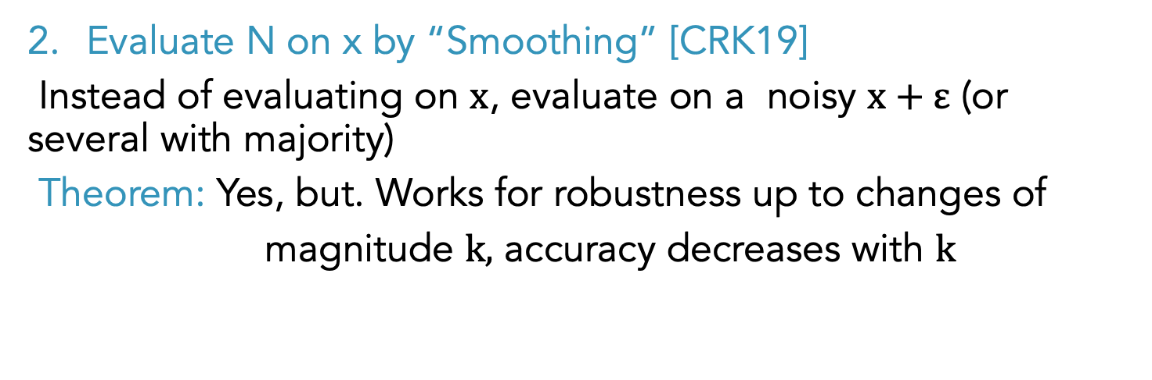
Takeaway 2 : Always Post Process to Immunize
Post-Processing Ideas:
Run extra GD iterations, perhaps on new data
Theorem: Backdoored N’ can be made into equivalent and similarly sized N’’ which is persistent to any number of GD iterations with any loss function, in linear time
Evaluate N on x by “Smoothing” [CRK19]
Instead of evaluating on $x$, evaluate on a noisy $x+ε$ (or several with majority)
Theorem: Yes, but. Works for robustness up to changes of
magnitude $k,$ accuracy decreases with $k$
Notes:
Depth d+2, O(N’) size,
c
CRK19, Zico, certfied robustness, we actually imorove their work, show for any network
Formally, we show that if the ground truth and input distribution f ? , D|X "behave nicely", then every learned h (that is, a function that approximates f ? with respect to D|X ) can be efficiently converted, on evaluation time, to a different function h˜ that also approximates f ? and at the same time inherits the "nice behavior" of f ? . Hence, conditions that certify that f ? does not have adversarial examples translate to a certification that h˜ does not have an adversarial example as well.

Slide 39
Takeaway 3: roadblock to verifying robustness
Corallary: under crypto assumptions,
it is impossible to verify/certify that a model is robust
Otherwise, Certification algorithm = distinguisher!
Notes:
s. Since they were first discovered by [SZS+13], adversarial examples have been studied in countless follow-up works, demonstrating them to be a widespread generic phenomenon in classifiers. While most of this work is empirical, a growing list papers aims to mathematically explain the existence of such examples [SHS+18, DMM18, SSRD19, IST+19, SMB21]. In a nutshell, the works of [SHS+18, DMM18] showed that a consequence of the concentration of high-dimensional measures [Tal95] is that random vectors in d dimensions are very likely to be O( √ d)-close to the boundary of any non-trivial classifier. Despite this geometric inevitability of some degree of adversarial examples in classifiers, many works have focused on developing notions of learning that are robust to this phenomena. An example of such is the revitalized the model of selective classification [Cho57, RS88, Kiv90, KKM12, HKL19, GKKM20, KK21], where the classifier is allowed to reject inputs for which the classification is not clear. Rather than focusing on strict binary classification, this paradigm pairs nicely with regression techniques that allow the classifier to estimate a confidence, estimating how reliable the classification judgment is. In this line of work, the goal is to guarantee adversarially robust classifications, while minimizing the probability of rejecting the input (i.e., outputting “Don’t Know”). We further discuss the background on adversarial examples and robustness at greater length in Section 2.6. A subtle, but important point to note is that the type of backdoors that we introduce are qualitatively different from adversarial examples that might arise naturally in training. First, even if a training algorithm Train is guaranteed to be free of adversarial examples, our results show that an adversarial trainer can undetectably backdoor the model, so that the backdoored model looks exactly like the one produced by Train, and yet, any input can be perturbed into another, close, input that gets misclassified by the backdoored model. Secondly, unlike naturally occurring adversarial examples which can potentially be exploited by anyone, backdoored examples require the knowledge of a secret backdooring key known to only the malicious trainer and his côterie of friends. Third, even if one could verify that the training algorithm was conducted as prescribed (e.g. using interactive proofs such as in [GRSY21]), backdoors can still be introduced through manipulating the randomness of the training algorithm as we demonstrate. Fourth and finally, we demonstrate that the perturbation required to change an input into a backdoored input (namely, ≈ d for some small >

Slide 40

Trust In Generative Models?

Slide 41
Challeneges in Generative LARGE Language Models(LLM)
Verify LLM data sources
Distinguish fact from fiction for generated sequences
Prevent and detect bias of LLM
Detect LLM outputs: Watermarking [Aa22, CGZ23]
How to ensure plurality of opinions
Can we employ black box methods versus dive into guts of models to improve on LLM
Prevent & Estimate black swan events
Define rigorously regulation and propose rigorous methods to enforce them

Slide 42
Data Governance is Important
Regulations or business contracts may require to use or not use certain data
How can we prove what dataset was used to create a model?
Current methods too slow
(“Proof-of-Learning”, Jia et al ’21, “Proof of Data”, Shavit et al 23): save checkpoints during training, verifier retrains on a random subset of segments
Verifiable AI standards/regulations (that don’t require trusting the companies)

Slide 43
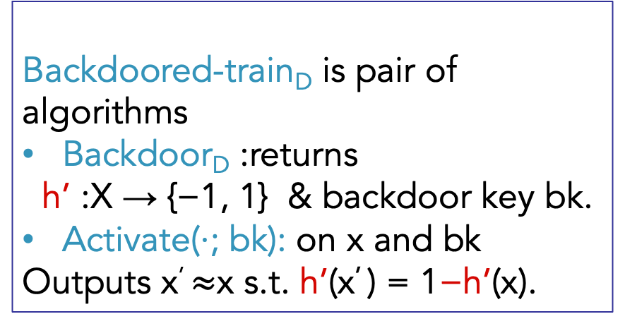
Backdoor is Undetectable
Train_{D} is a training
which returns classifier
h : X → {−1, 1}.
Backdoored-train_{D} is pair of algorithms
Backdoor_{D} :returns
h’ :X → {−1, 1} & backdoor key bk.
Activate(·; bk): on x and bk
Outputs x’ $≈$x s.t. h’(x’ ) = 1−h’(x).
Undetectable if:
h’ ← Backdoor_{D} is computationally-indistinguishable
from
h ← Train_{D}

